Slide 1
Datascience
Demo

Slide 2
What we will learn?.
Need
What
Use case
Bi vs DS
Tools
Life cycle

Slide 3
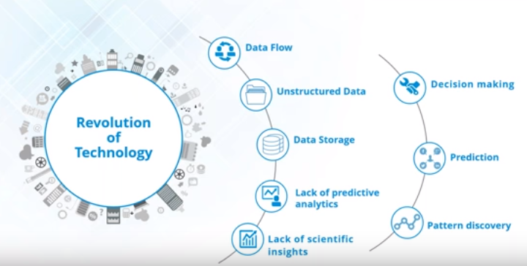
Need of Datascience

Slide 4
What is datascience?.
Datascience is a blend of various tools,algorithms, and ML principles with the goal to discover the hidden patterns from the raw data.
It is primarily used to make decisions and predictions

Slide 5
Use case - Amazon
Amazon has got a huge data of customers like age, sex, location etc..
Depending upon the data they draw patterns to sell a right product to the right customer
Other use case is google self driving cars

Slide 6
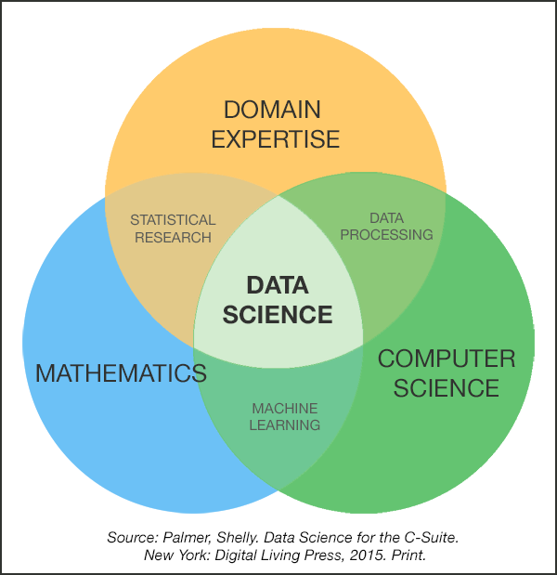
Skills of a datascientist

Slide 7
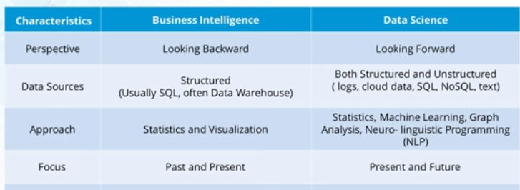
BI vs DS

Slide 8
Lifecycle of Datscience
Discovery
Data preparation
Model Planning
Model Building
Deployment

